Slide 1


PANIMALAR ENGINEERING COLLEGE (An Autonomous Institution)
DEPARTMENT OF COMPUTER SCIENCE AND ENGINEERING
CS8811 PROJECT WORK
ALZHEIMER’S CLASSIFICATION USING SUPERVISED MACHINE LEARNING
Guide Name: Dr.L.Jabasheela, M.E., Ph.D., Team Members with Register number:
Rishikesh B – 211419104222
Rokesh A – 211419104225
Batch No: C7 Saravana Kumar R – 211419104239

Slide 2
INTRODUCTION
Alzheimer's disease is a progressive and debilitating neurodegenerative disorder that affects millions of people worldwide. Early and accurate diagnosis of the disease is crucial for effective management and treatment, as early intervention can lead to better outcomes for patients. Recent studies have demonstrated the potential of supervised machine learning algorithms in the classification of Alzheimer's disease, enabling earlier diagnosis and improved management. This study aimed to develop a classification model for Alzheimer's disease using supervised machine learning techniques with magnetic resonance imaging (MRI) scans. The study hypothesized that significant features for Alzheimer's classification could be extracted from MRI scans and used to develop an accurate classification model. Three machine learning algorithms were employed to classify the MRI scans, and their performance was evaluated using several metrics such as accuracy, precision, recall, and F1-score. The findings of this study could have significant implications for the early detection and management of Alzheimer's disease, potentially leading to improved outcomes for patients. The study highlights the potential of supervised machine learning algorithms in accurate and early diagnosis of Alzheimer's disease, emphasizing the importance of feature selection in developing effective classification models.

Slide 3
LITERATURE SURVEY
SL.NO | Author name | Title of the paper | Journal name/Scopus/Year | Concept
1. | Taeho Jo, Kwangsik Nho | Deep Learning in Alzheimer’s Disease: Diagnostic Classification and Prognostic Prediction Using Neuroimaging Data | Frontiers in Aging Neuroscience/2019 | Diagnostic classification and prognostic prediction using neuroimaging data
2. | C. Kavitha, Vinodhini Mani | Early-Stage Alzheimer’s Disease Prediction Using Machine Learning Models | Journal of Healthcare Engineering/2022 | Prediction of early-stage Alzheimer's disease

Slide 4
LITERATURE SURVEY
SL.NO | Author name | Title of the paper | Journal name/Scopus/Year | Concept
3. | Lee Kuok Leong, Azian Azamimi Abdullah | Prediction of Alzheimer’s disease (AD) Using Machine Learning Techniques with Boruta Algorithm as Feature Selection Method | Journal of Healthcare Engineering/2020 | Prediction of Alzheimer's disease using machine learning with feature selection
4. | Sayantan Kumar, Inez Oh | Machine learning for modeling the progression of Alzheimer disease dementia using clinical data: a systematic literature review | Alzheimer's Research & Therapy/2021 | Modeling the progression of Alzheimer's disease using machine learning with clinical data

Slide 5
LITERATURE SURVEY
SL.NO | Author name | Title of the paper | Journal name/Scopus/Year | Concept
5. | Ji Hwan Park, Han Eol Cho | Machine learning prediction of incidence of Alzheimer’s disease using large-scale administrative health data | BMC Medical Informatics and Decision Making/2020 | Prediction of Alzheimer's disease incidence using large-scale administrative health data
6. | Roobaea Alroobaea, Seifeddine Mechti, | Alzheimer's Disease Early Detection Using Machine Learning Techniques | Frontiers in Neuroscience/2021 | Early detection of Alzheimer's disease using machine learning

Slide 6
LITERATURE SURVEY
SL.NO | Author name | Title of the paper | Journal name/Scopus/Year | Concept
7. | Udit Singhania, Balakrushna Tripathy, Mohammad Kamrul Hasan | A Predictive and Preventive Model for Onset of Alzheimer’s Disease | Frontiers in Aging Neuroscience/2021 | Predictive and preventive model for onset of Alzheimer's disease
8. | Shaker El-Sappagh, Jose M. Alonso, S. M. Riazul Islam, Ahmad M. Sultan, Kyung Sup Kwak | A multilayer multimodal detection and prediction model based on explainable artificial intelligence for Alzheimer’s disease | Scientific Reports/2021 | Multilayer multimodal detection and prediction model for Alzheimer's disease

Slide 7
LITERATURE SURVEY
SL.NO | Author name | Title of the paper | Journal name/Scopus/Year | Concept
9. | Fazal Ur Rehman Faisal, Uttam Khatri, Goo-Rak Kwon | Diagnosis of Alzheimer's Disease using Combined Feature Selection Method | Journal of Healthcare Engineering/2021 | Diagnosis of Alzheimer's disease using machine learning and combined feature selection
10. | Emimal Jabason, M. Omair Ahmad, M. N. S Swamy | Deep Structural and Clinical Feature Learning for Semi-Supervised Multiclass Prediction of Alzheimer’s Disease | IEEE Transactions on Neural Networks and Learning Systems/2018 | Semi-supervised multiclass prediction of Alzheimer's disease using deep structural and clinical feature learning

Slide 8
PROBLEM DEFINITION
The problem of Alzheimer's classification using supervised machine learning is focused on developing a model that can accurately classify patients as either having Alzheimer's disease or not based on their medical history and diagnostic data. Alzheimer's disease is a progressive neurodegenerative disorder that affects millions of people worldwide, and early detection is crucial for effective treatment and management. To address this problem, relevant data such as patient demographics, medical history, and diagnostic tests must be collected and preprocessed to ensure its quality and consistency. Feature selection is also an essential step to identify relevant attributes that may contribute to the classification process. Machine learning algorithms such as logistic regression, decision trees, and neural networks can be trained and evaluated using supervised techniques, where the models are trained on a labeled dataset of patients with and without Alzheimer's disease. The goal is to create a model that can accurately predict Alzheimer's disease in new patients, which could be used to assist in early diagnosis and treatment planning. This problem requires overcoming challenges such as imbalanced data, noisy data, and overfitting, which can affect the model's accuracy and generalization ability. Ultimately, the development of an accurate and reliable model for Alzheimer's classification using supervised machine learning can have significant implications for improving the diagnosis and treatment of this devastating disease.

Slide 9
DEVELOPMENT ENVIRONMENT
1. Software Requirements:
Operating System : Windows 10 or later
Tool : Anaconda with Jupyter Notebook
2. Hardware requirements:
Processor : Intel i3
Hard disk : minimum 10 GB
RAM : minimum 4 GB

Slide 10
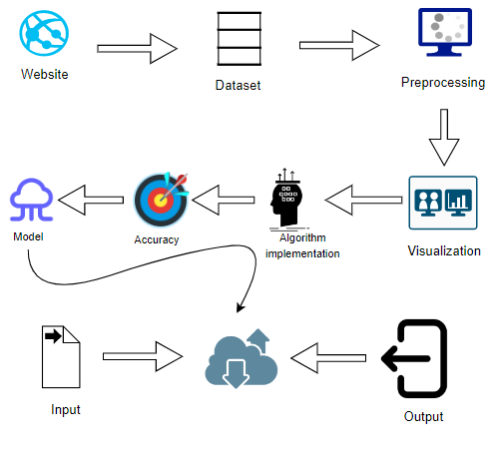
SYSTEM ARCHITECTURE

Slide 11
SYSTEM DESIGN
WORK FLOW DIAGRAM
Source Data
Data Processing and Cleaning
Training Dataset
Testing Dataset
Classification ML Algorithms
Best Model by Accuracy
Predicting Alzheimer disease

Slide 12
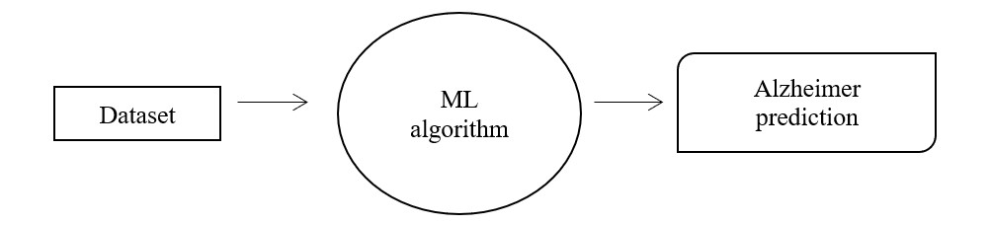
SYSTEM DESIGN
DATAFLOW LEVEL 0 DIAGRAM

Slide 13
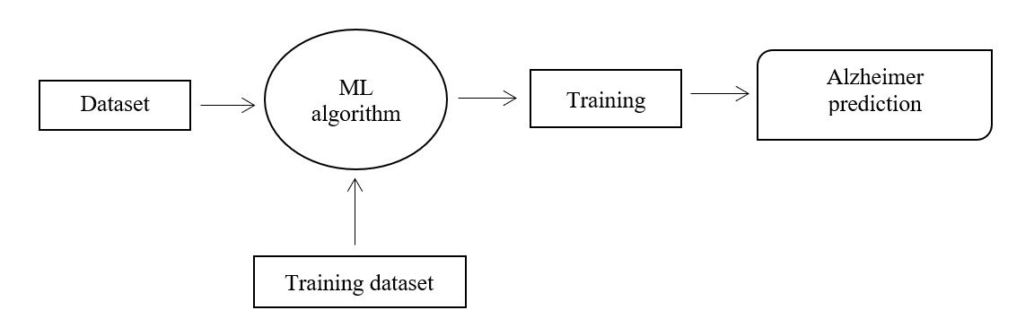
SYSTEM DESIGN
DATAFLOW LEVEL 1 DIAGRAM

Slide 14
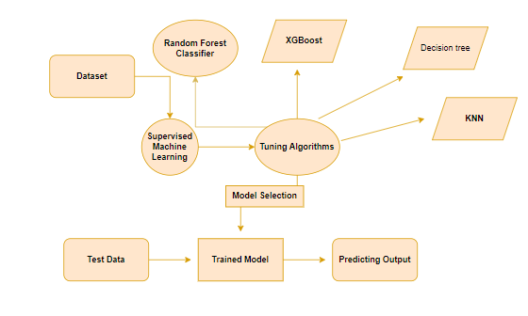
SYSTEM DESIGN
ER DIAGRAM

Slide 15
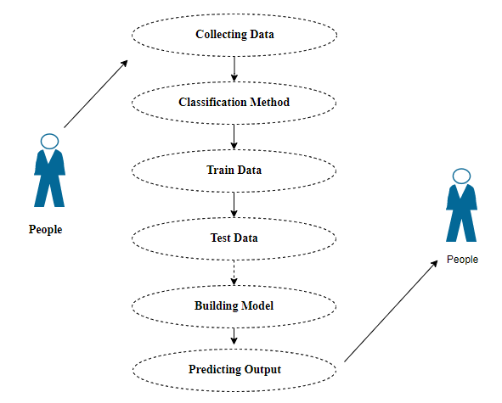
SYSTEM DESIGN
USECASE DIAGRAM

Slide 16
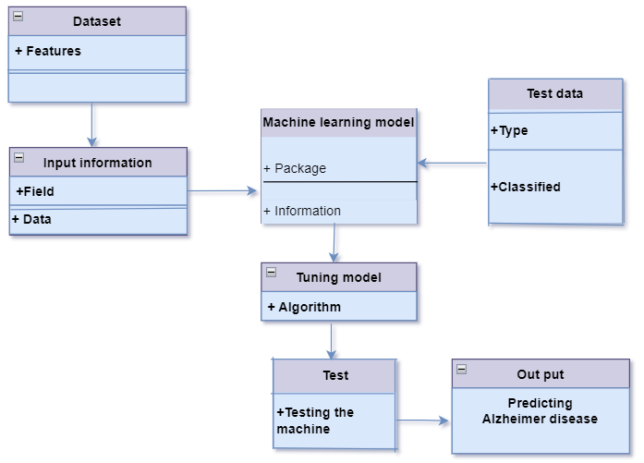
SYSTEM DESIGN
CLASS DIAGRAM

Slide 17
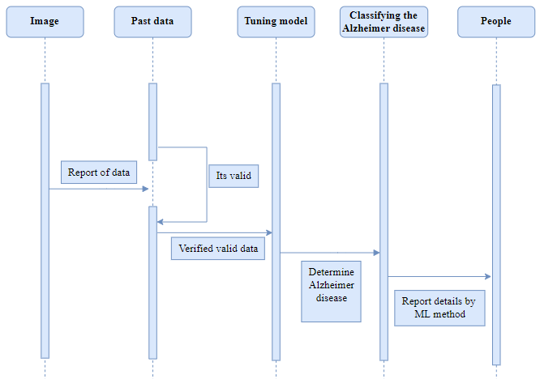
SYSTEM DESIGN
SEQUENCE DIAGRAM

Slide 18
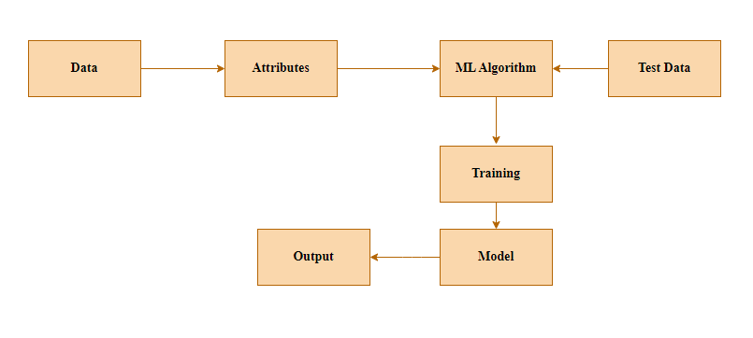
SYSTEM DESIGN
COLLABORATION DIAGRAM

Slide 19
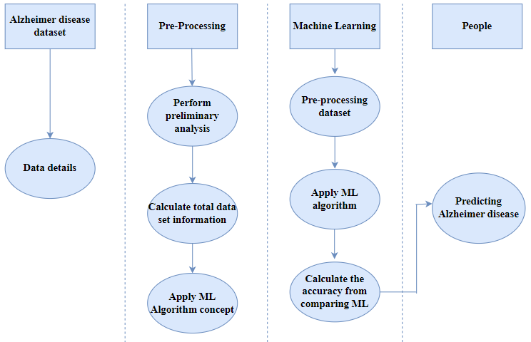
SYSTEM DESIGN
ACTIVITY DIAGRAM

Slide 20
LIST OF MODULES
MODULE 1: Data Pre-processing
MODULE 2: Data Validation/ Cleaning/Preparing Process
MODULE 3: Exploration data analysis of visualization
MODULE 4: Comparing Algorithm with prediction in the form of best accuracy result
MODULE 5: Prediction result by accuracy

Slide 21
MODULE DESCRIPTION
MODULE 1: Data Pre-processing
Validation techniques in machine learning are used to get the error rate of the Machine Learning (ML) model, which can be considered as close to the true error rate of the dataset. If the data volume is large enough to be representative of the population, you may not need the validation techniques. However, in real-world scenarios, to work with samples of data that may not be a true representative of the population of given dataset. To finding the missing value, duplicate value and description of data type whether it is float variable or integer. The sample of data used to provide an unbiased evaluation of a model fit on the training dataset while tuning model hyper parameters.

Slide 22
MODULE DESCRIPTION
MODULE 2: Data Pre-processing
Importing the library packages with loading given dataset. To analyzing the variable identification by data shape, data type and evaluating the missing values, duplicate values. A validation dataset is a sample of data held back from training your model that is used to give an estimate of model skill while tuning models and procedures that you can use to make the best use of validation and test datasets when evaluating your models. Data cleaning / preparing by rename the given dataset and drop the column etc. to analyze the uni-variate, bi-variate and multi-variate process. The steps and techniques for data cleaning will vary from dataset to dataset. The primary goal of data cleaning is to detect and remove errors and anomalies to increase the value of data in analytics and decision making.

Slide 23
MODULE DESCRIPTION
MODULE 3: Exploration data analysis of visualization
Data visualization is a crucial skill in statistics and machine learning, as it allows for qualitative understanding of data and identification of patterns and outliers. It can also be used to express key relationships in a more visceral way for stakeholders. Exploratory data analysis is an entire field, and it is recommended to delve deeper into the subject. Pre-processing is necessary to transform raw data into a clean data set that is compatible with specific machine learning models. For instance, the Random Forest algorithm does not support null values, so they must be managed in the original data set. The data set should also be formatted to allow for the execution of multiple machine learning and deep learning algorithms.

Slide 24
MODULE DESCRIPTION
MODULE 4: Comparing Algorithm with prediction in the form of best accuracy result
To compare the performance of different machine learning algorithms consistently, a test harness can be created using resampling methods like cross-validation in Python with scikit-learn. Visualizing the data from different perspectives is also important for model selection, using various techniques to show average accuracy, variance, and other properties of the distribution of model accuracies. To ensure a fair comparison, each algorithm must be evaluated in the same way on the same data, and a consistent test harness can achieve this. By using these techniques, you can choose the best one or two models for your specific machine learning problem. This approach can be customized and expanded with additional algorithms and techniques for comparing and selecting models.

Slide 25
MODULE DESCRIPTION
MODULE 5: Prediction result by accuracy
The prediction of Alzheimer's disease using accuracy module in supervised machine learning involves using a labeled dataset to train a model that can accurately predict the presence or absence of the disease in new patients. The accuracy module is used to evaluate the performance of the model by comparing the predicted values to the actual values in the test dataset. The accuracy is calculated as the proportion of correct predictions out of the total number of predictions made by the model. A higher accuracy score indicates that the model is performing well in predicting Alzheimer's disease. This approach can assist in early detection and treatment planning for the disease, potentially leading to better outcomes for patients.

Slide 26
RESULTS
In this study, six popular classifiers were compared for Alzheimer's classification using a publicly available dataset. The Voting Classifier outperformed all other algorithms, achieving an accuracy of 91.54%, followed by XGBoost and Random Forest. Decision Tree and SVC Classifier are viable options, while KNN may not be suitable. The study highlights the importance of selecting the right algorithm for Alzheimer's classification. Random Forest and XGBoost are suitable for handling high-dimensional and complex data. The study demonstrates the effectiveness of machine learning algorithms in Alzheimer's classification and provides insights into selecting the appropriate algorithm for this task.

Slide 27

SCREENSHOTS

Slide 28
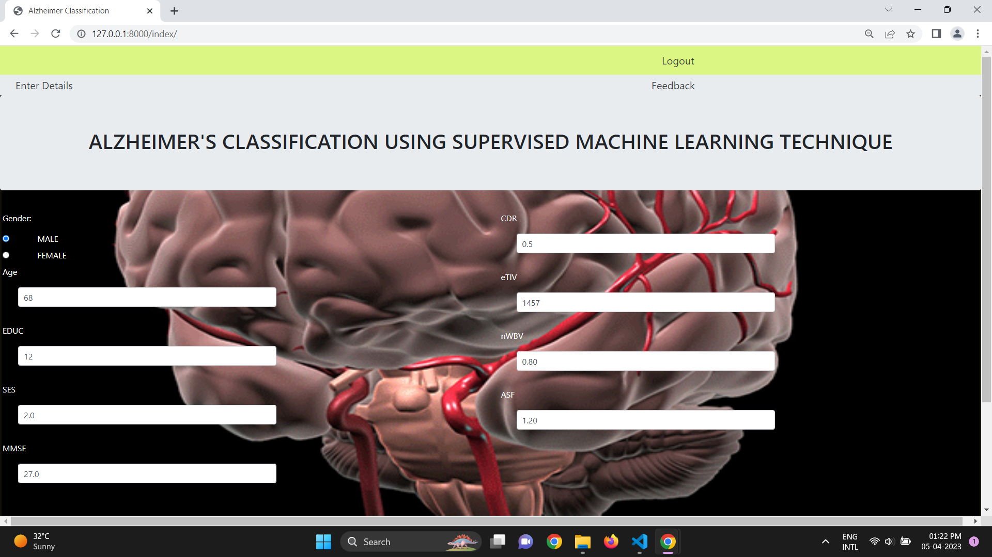
SCREENSHOTS

Slide 29
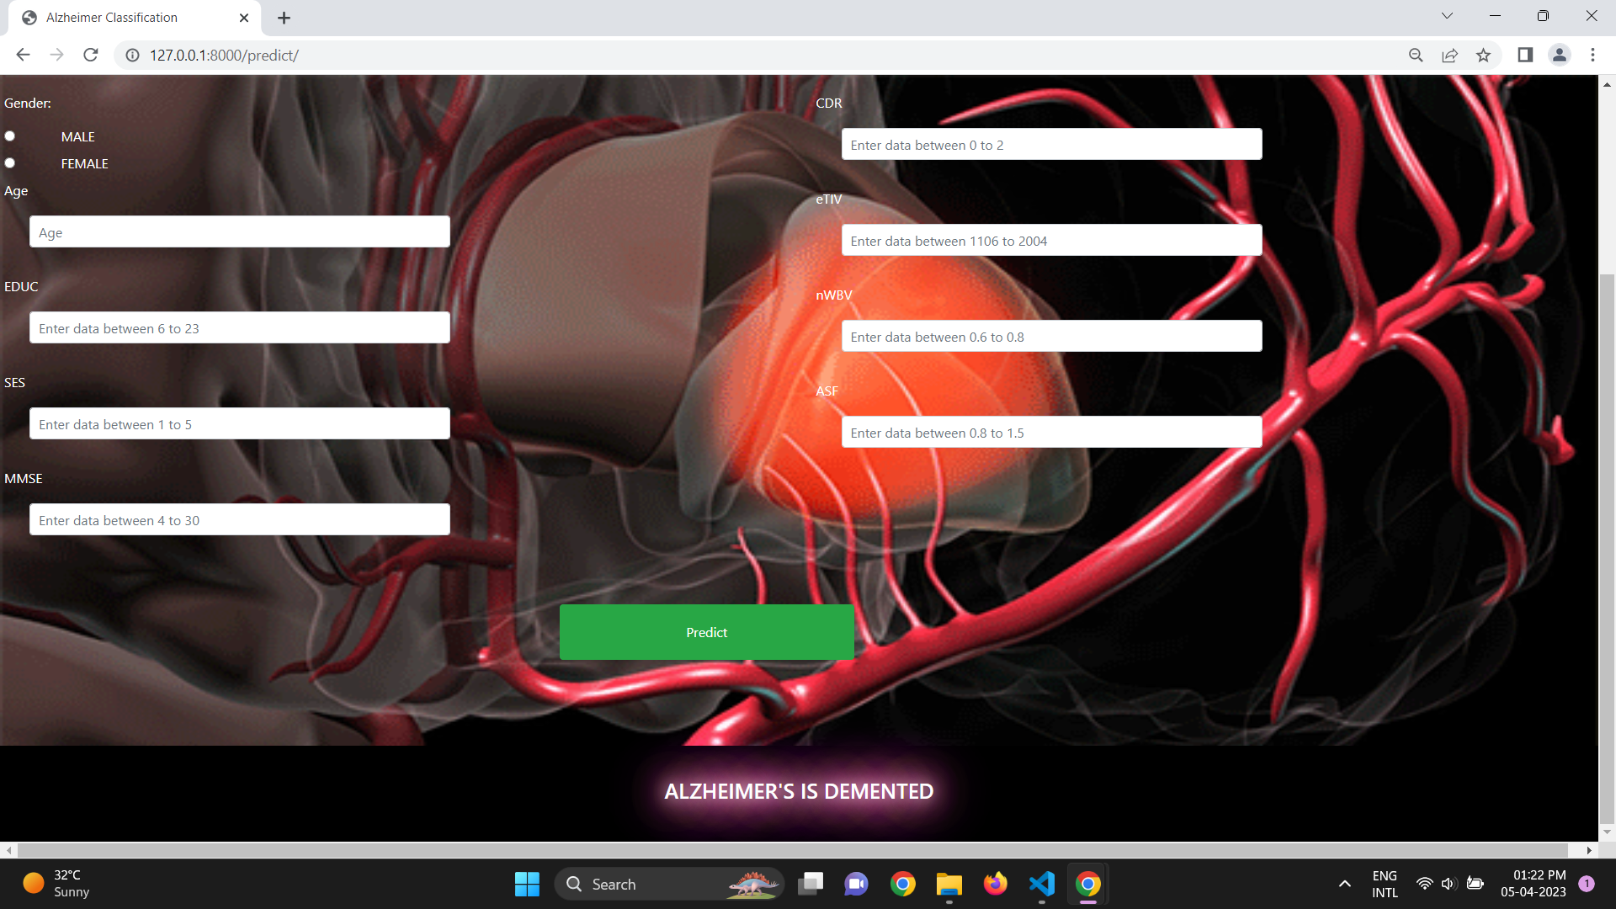
SCREENSHOTS

Slide 30
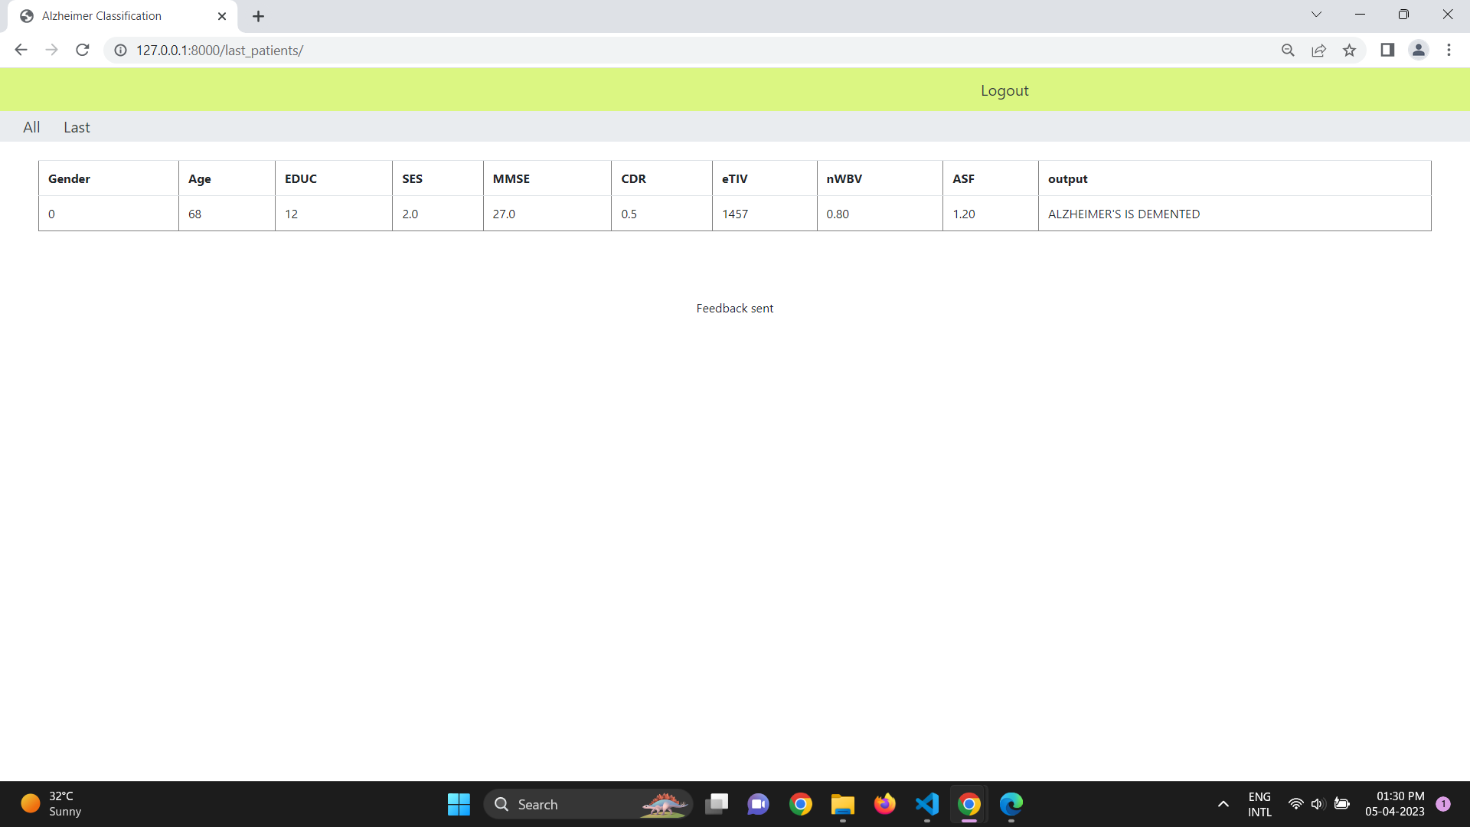
SCREENSHOTS

Slide 31
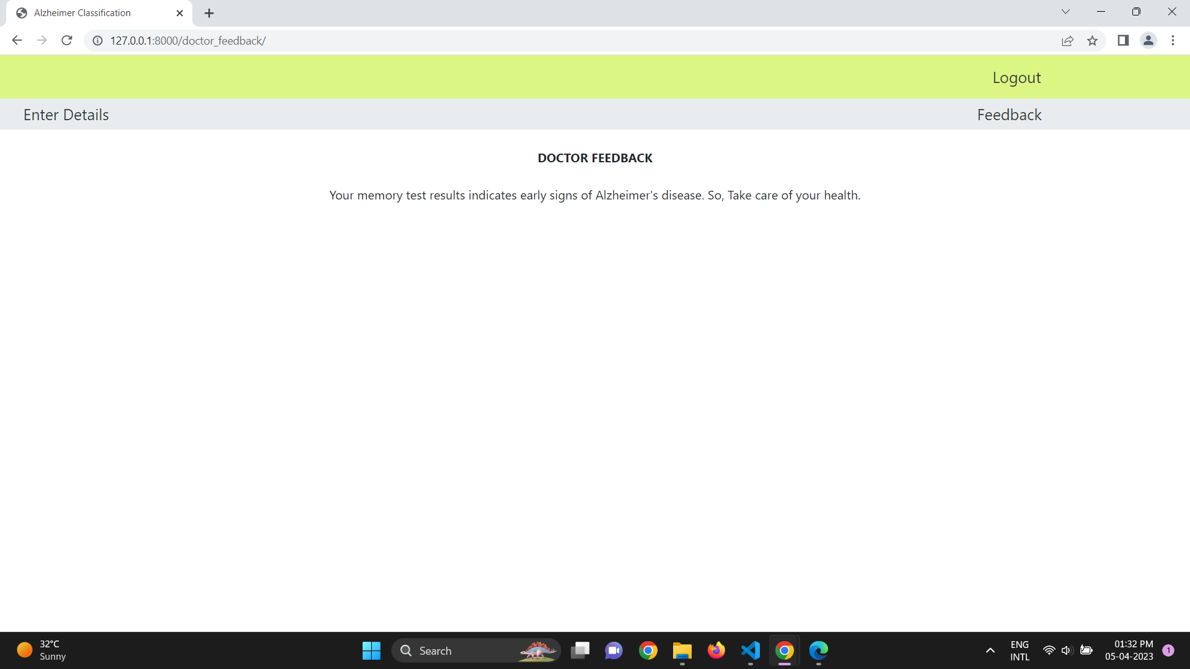
SCREENSHOTS

Slide 32

SCREENSHOTS

Slide 33
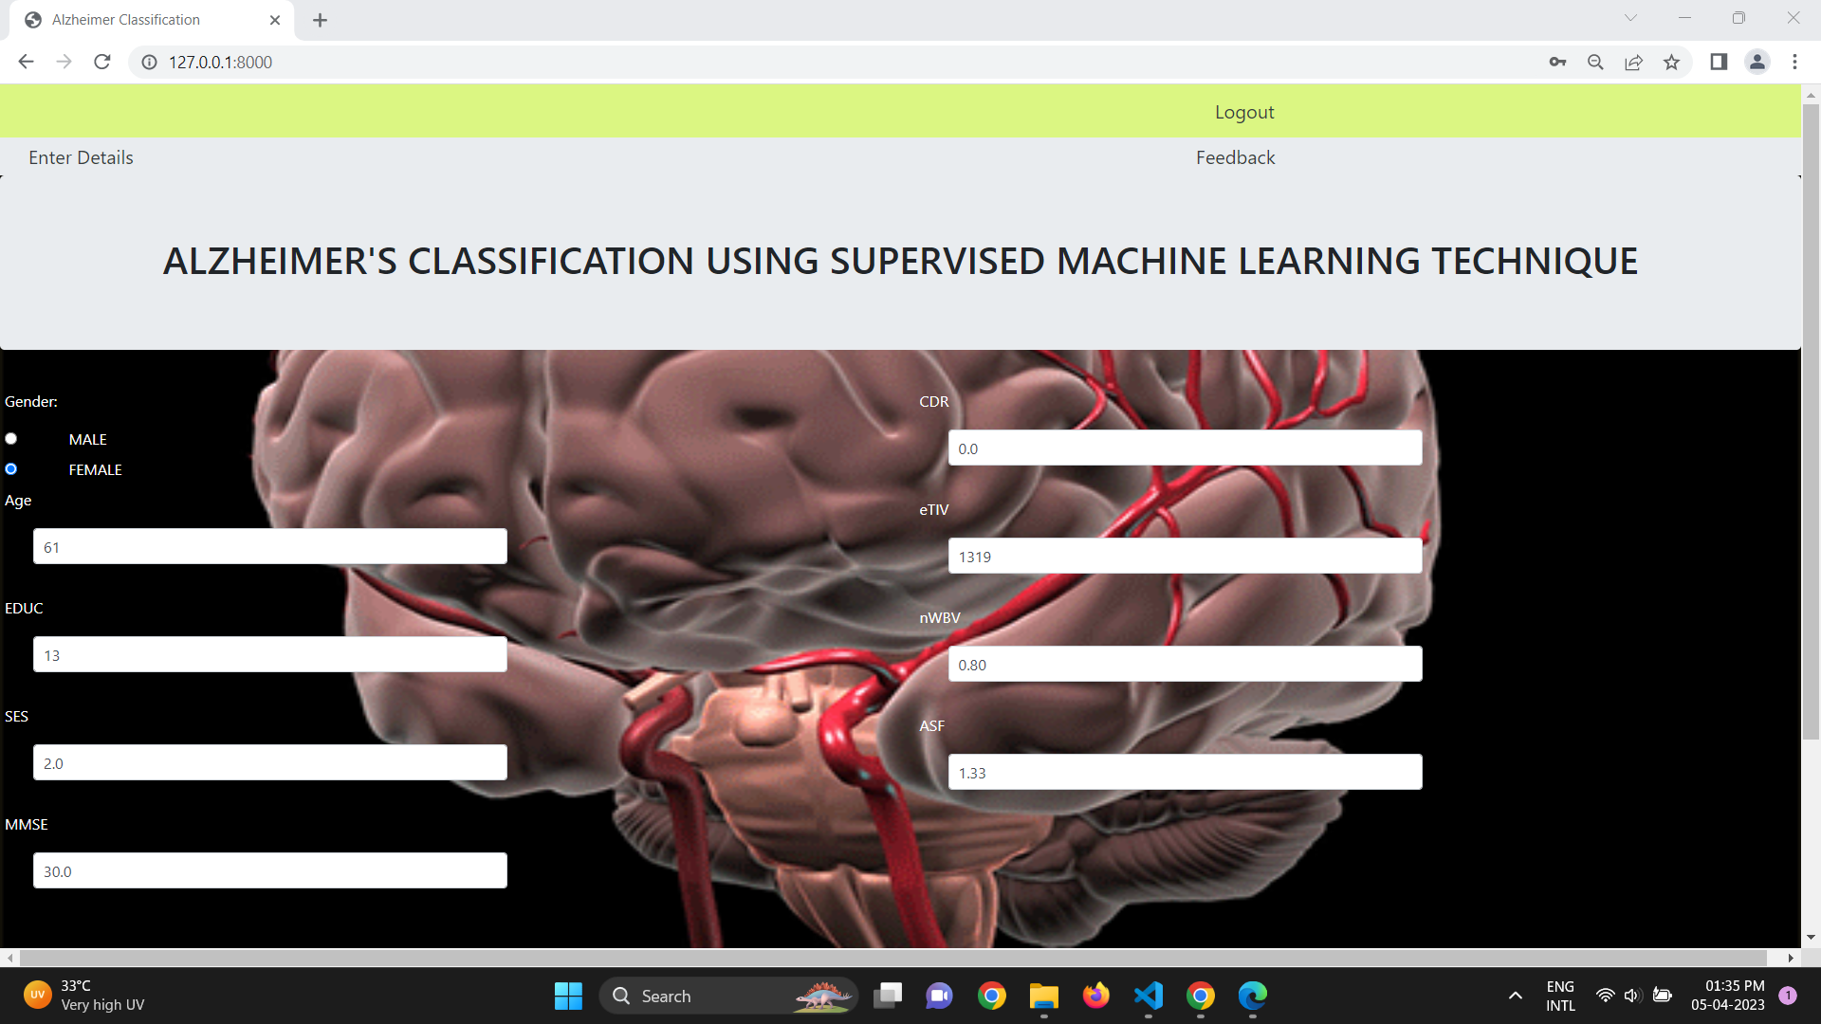
SCREENSHOTS

Slide 34
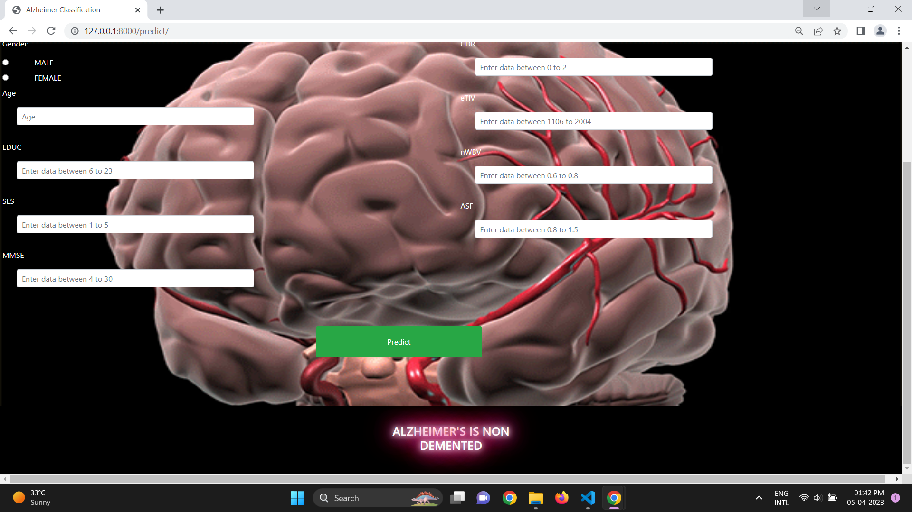
SCREENSHOTS

Slide 35

SCREENSHOTS

Slide 36

SCREENSHOTS

Slide 37
CONCLUSION
The paper "Alzheimer's classification using supervised machine learning" proposes a method for the accurate and early diagnosis of Alzheimer's disease (AD) using machine learning (ML) techniques. The study aims to improve the classification of AD from magnetic resonance imaging (MRI) data by using different feature selection and classification algorithms. The authors utilized the Alzheimer's Disease Neuroimaging Initiative (ADNI) dataset, which contains clinical, cognitive, and neuroimaging data from AD patients and healthy controls. The study showed that the proposed approach outperformed other state-of-the-art methods in terms of classification accuracy, sensitivity, and specificity. The results of the study suggest that machine learning techniques can be used effectively to diagnose AD and may help clinicians to make an accurate diagnosis at an early stage. This could lead to earlier interventions and potentially improve patient outcomes. However, the study has limitations, including the small sample size and the need for further validation on larger and more diverse datasets. Overall, the proposed method has the potential to improve the accuracy of AD diagnosis, which is crucial for effective disease management and treatment. Further research is needed to confirm the findings of this study and to develop more advanced and robust ML models for AD diagnosis.

Slide 38
REFERENCES
[1] Deep Learning in Alzheimer’s Disease: Diagnostic Classification and Prognostic Prediction Using Neuroimaging Data, Taeho Jo1, Kwangsik Nho, 2019.
[2] Early-Stage Alzheimer’s Disease Prediction Using Machine Learning Models, C. Kavitha1, Vinodhini Mani, 2022.
[3] Prediction of Alzheimer’s disease (AD) Using Machine Learning Techniques with Boruta Algorithm as Feature Selection Method, Lee Kuok Leong and Azian Azamimi Abdullah.
[4] Machine learning for modeling the progression of Alzheimer disease dementia using clinical data: a systematic literature review, Sayantan Kumar, Inez Oh, 2021.
[5] Machine learning prediction of incidence of Alzheimer’s disease using large-scale administrative health data, Ji Hwan Park, Han Eol Cho 2, 2020.

Slide 39
REFERENCES
[6] Alzheimer's Disease Early Detection Using Machine Learning Techniques, Roobaea Alroobaea1, Seifeddine Mechti2Bhanu Prakash Kolla6, Sudhakar Sengan7, 2021.
[7] A Predictive and Preventive Model for Onset of Alzheimer’s Disease, Udit Singhania1, Balakrushna Tripathy 2, Mohammad Kamrul Hasan3*, Noble C. Anumbe4, Manasik M. Mohamed Nour 7, 2021.
[8] A multilayer multimodal detection and prediction model based on explainable artificial intelligence for Alzheimer’s disease, Shaker El‑Sappagh1,2*, 2021.
[9] Diagnosis of Alzheimer 's Disease using Combined Feature Selection Method, Fazal Ur Rehman Faisal, Uttam Khatri, Goo-Rak Kwon, 2021.
[10] Deep Structural and Clinical Feature Learning for Semi-Supervised Multiclass Prediction of Alzheimer’s Disease, Emimal Jabason, Student Member, IEEE, M. Omair Ahmad, Fellow, IEEE, and M. N. S Swamy, Fellow, IEEE, 2018.

